Slide 1
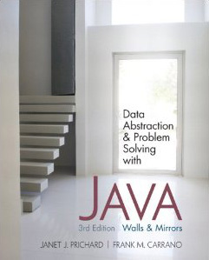
Chapter 6
Recursion as a Problem-Solving Technique
© 2011 Pearson Addison-Wesley. All rights reserved
6-<number>

Slide 2
Backtracking
Backtracking
  A strategy for guessing at a solution and backing up when an impasse is reached
Recursion and backtracking can be combined to solve problems
© 2011 Pearson Addison-Wesley. All rights reserved
6-<number>

Slide 3
The Eight Queens Problem
Problem
  Place eight queens on the chessboard so that no queen can attack any other queen
Strategy: guess at a solution
  There are 4,426,165,368 ways to arrange 8 queens on a chessboard of 64 squares
© 2011 Pearson Addison-Wesley. All rights reserved
6-<number>

Slide 4
The Eight Queens Problem
An observation that eliminates many arrangements from consideration
  No queen can reside in a row or a column that contains another queen
    Now: only 40,320 arrangements of queens to be checked for attacks along diagonals
© 2011 Pearson Addison-Wesley. All rights reserved
6-<number>

Slide 5
The Eight Queens Problem
Providing organization for the guessing strategy
  Place queens one column at a time
  If you reach an impasse, backtrack to the previous column
© 2011 Pearson Addison-Wesley. All rights reserved
6-<number>

Slide 6
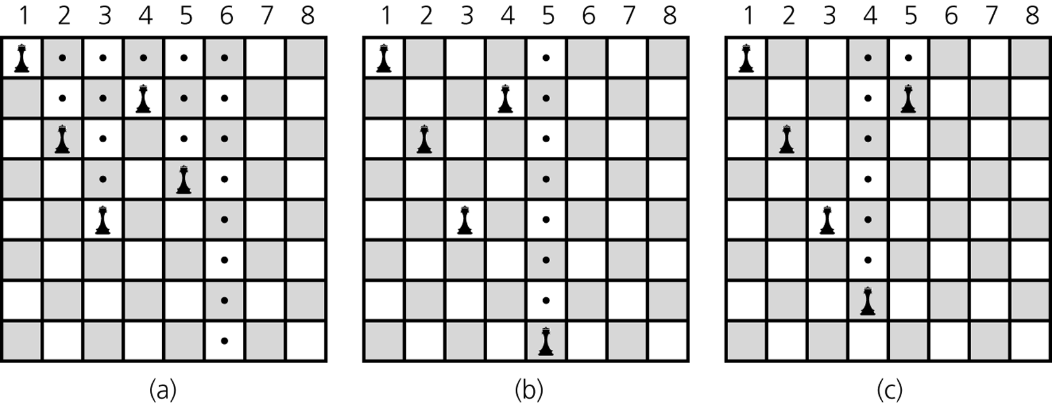
The Eight Queens Problem
Figure 6-1
a) Five queens that cannot attack each other, but that can attack all of
column 6; b) backtracking to column 5 to try another square for the queen;
c) backtracking to column 4 to try another square for the queen and then considering column 5 again
© 2011 Pearson Addison-Wesley. All rights reserved
6-<number>

Slide 7
The Eight Queens Problem
A recursive algorithm that places a queen in a column
  Base case
    If there are no more columns to consider
      You are finished
  Recursive step
    If you successfully place a queen in the current column
      Consider the next column
    If you cannot place a queen in the current column
      You need to backtrack
© 2011 Pearson Addison-Wesley. All rights reserved
6-<number>

Slide 8
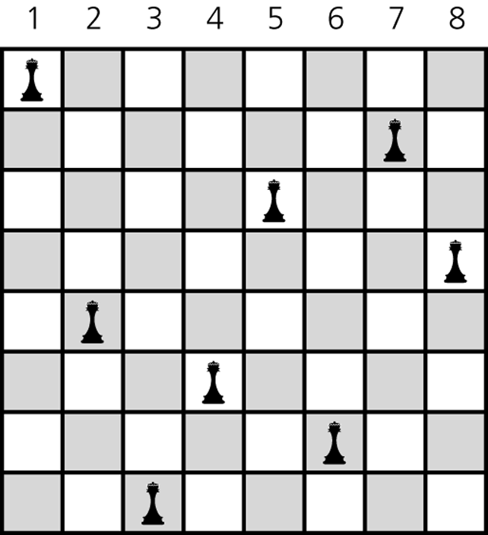
The Eight Queens Problem
Figure 6-2
A solution to the Eight Queens problem
© 2011 Pearson Addison-Wesley. All rights reserved
6-<number>

Slide 9
Defining Languages
A language
  A set of strings of symbols
  Examples: English, Java
  If a Java program is one long string of characters, the language JavaPrograms is defined as
  JavaPrograms = {strings w : w is a syntactically correct Java program}
© 2011 Pearson Addison-Wesley. All rights reserved
6-<number>

Slide 10
Defining Languages
A language does not have to be a programming or a communication language
  Example
    The set of algebraic expressions
      AlgebraicExpressions = {w : w is an algebraic expression}
© 2011 Pearson Addison-Wesley. All rights reserved
6-<number>

Slide 11
Defining Languages
Grammar
  States the rules for forming the strings in a language
Benefit of recursive grammars
  Ease of writing a recognition algorithm for the language
    A recognition algorithm determines whether a given string is in the language
© 2011 Pearson Addison-Wesley. All rights reserved
6-<number>

Slide 12
The Basics of Grammars
Symbols used in grammars
  x | y means x or y
  x y means x followed by y
  (In x • y, the symbol • means concatenate, or append)
  < word > means any instance of word that the definition defines
© 2011 Pearson Addison-Wesley. All rights reserved
6-<number>

Slide 13
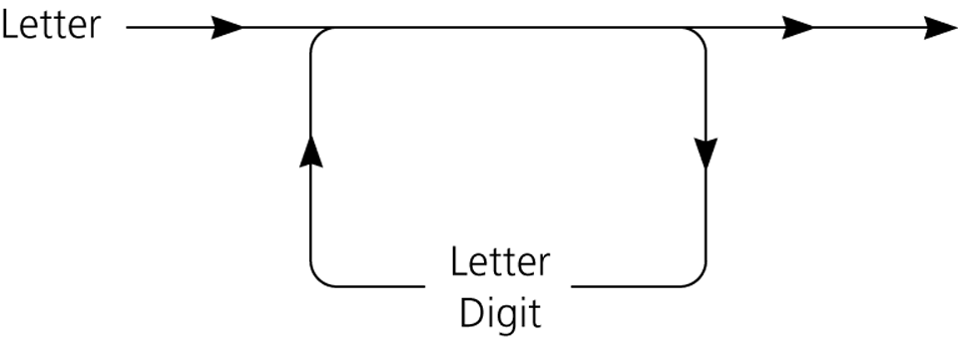
The Basics of Grammars
Java identifiers
  A Java identifier begins with a letter and is followed by zero or more letters and digits
Figure 6-3
A syntax diagram for Java identifiers
© 2011 Pearson Addison-Wesley. All rights reserved
6-<number>

Slide 14
The Basics of Grammars
Java identifiers
  Language
  JavaIds = {w : w is a legal Java identifier}
  Grammar
    < identifier > = < letter > | < identifier > < letter > | < identifier > < digit>
    < letter > = a | b | … | z | A | B | …| Z | _ | $
    < digit > = 0 | 1 | … | 9
© 2011 Pearson Addison-Wesley. All rights reserved
6-<number>

Slide 15
The Basics of Grammars
Recognition algorithm
  isId(w)
  if (w is of length 1) {
  if (w is a letter) {
  return true
  }
  else {
  return false
  }
  }
  else if (the last character of w is a letter or a digit) {
  return isId(w minus its last character)
  }
  else {
  return false
  }
© 2011 Pearson Addison-Wesley. All rights reserved
6-<number>

Slide 16
Two Simple Languages: Palindromes
A string that reads the same from left to right as it does from right to left
Examples: radar, deed
Language
  Palindromes = {w : w reads the same left to right as
    right to left}
© 2011 Pearson Addison-Wesley. All rights reserved
6-<number>

Slide 17
Palindromes
Grammar
  < pal > = empty string | < ch > | a < pal > a | b < pal > b | …
    | Z < pal > Z
  < ch > = a | b | … | z | A | B | … | Z
© 2011 Pearson Addison-Wesley. All rights reserved
6-<number>

Slide 18
Palindromes
Recognition algorithm
  isPal(w)
  if (w is the empty string or w is of length 1) {
  return true
  }
  else if (w’s first and last characters are the same letter ) {
  return isPal(w minus its first and last characters)
  }
  else {
  return false
  }
© 2011 Pearson Addison-Wesley. All rights reserved
6-<number>

Slide 19
Strings of the form A^{n}B^{n}
A^{n}B^{n}
  The string that consists of n consecutive A’s followed by n consecutive B’s
Language
  L = {w : w is of the form A^{n}B^{n} for some n ≥ 0}
Grammar
  < legal-word > = empty string | A < legal-word > B
© 2011 Pearson Addison-Wesley. All rights reserved
6-<number>

Slide 20
Strings of the form A^{n}B^{n}
Recognition algorithm
  isAnBn(w)
  if (the length of w is zero) {
  return true
  }
  else if (w begins with the character A and ends with the character B) {
  return isAnBn(w minus its first and last characters)
  }
  else {
  return false
  }
© 2011 Pearson Addison-Wesley. All rights reserved
6-<number>

Slide 21
Algebraic Expressions
Three languages for algebraic expressions
  Infix expressions
    An operator appears between its operands
    Example: a + b
  Prefix expressions
    An operator appears before its operands
    Example: + a b
  Postfix expressions
    An operator appears after its operands
    Example: a b +
© 2011 Pearson Addison-Wesley. All rights reserved
6-<number>

Slide 22
Algebraic Expressions
To convert a fully parenthesized infix expression to a prefix form
  Move each operator to the position marked by its corresponding open parenthesis
  Remove the parentheses
  Example
    Infix expression: ((a + b) * c
    Prefix expression: * + a b c
© 2011 Pearson Addison-Wesley. All rights reserved
6-<number>

Slide 23
Algebraic Expressions
To convert a fully parenthesized infix expression to a postfix form
  Move each operator to the position marked by its corresponding closing parenthesis
  Remove the parentheses
  Example
    Infix form: ((a + b) * c)
    Postfix form: a b + c *
© 2011 Pearson Addison-Wesley. All rights reserved
6-<number>

Slide 24
Algebraic Expressions
Prefix and postfix expressions
  Never need
    Precedence rules
    Association rules
    Parentheses
  Have
    Simple grammar expressions
    Straightforward recognition and evaluation algorithms
© 2011 Pearson Addison-Wesley. All rights reserved
6-<number>

Slide 25
Prefix Expressions
Grammar
  < prefix > = < identifier > | < operator > < prefix > < prefix >
  < operator > = + | - | * | /
  < identifier > = a | b | … | z
A recognition algorithm
  isPre()
  size = length of expression strExp
  lastChar = endPre(0, size – 1)
  if (lastChar >= 0 and lastChar == size-1 {
  return true
  }
  else {
  return false
  }
© 2011 Pearson Addison-Wesley. All rights reserved
6-<number>

Slide 26
Prefix Expressions
An algorithm that evaluates a prefix expression
  evaluatePrefix(strExp)
  ch = first character of expression strExp
  Delete first character from strExp
  if (ch is an identifier) {
  return value of the identifier
  }
  else if (ch is an operator named op) {
  operand1 = evaluatePrefix(strExp)
  operand2 = evaluatePrefix(strExp)
  return operand1 op operand2
  }
© 2011 Pearson Addison-Wesley. All rights reserved
6-<number>

Slide 27
Postfix Expressions
Grammar
  < postfix > = < identifier > | < postfix > < postfix > < operator>
  < operator > = + | - | * | /
  < identifier > = a | b | … | z
At high-level, an algorithm that converts a prefix expression to postfix form
  if (exp is a single letter) {
  return exp
  }
  else {
  return postfix(prefix1) + postfix(prefix2) + operator
  }
© 2011 Pearson Addison-Wesley. All rights reserved
6-<number>

Slide 28
Postfix Expressions
A recursive algorithm that converts a prefix expression to postfix form
  convert(pre)
  ch = first character of pre
  Delete first character of pre
  if (ch is a lowercase letter) {
  return ch as a string
  }
  else {
  postfix1 = convert(pre)
  postfix2 = convert(pre)
  return postfix1 + postfix2 + ch
  }
© 2011 Pearson Addison-Wesley. All rights reserved
6-<number>

Slide 29
Fully Parenthesized Expressions
To avoid ambiguity, infix notation normally requires
  Precedence rules
  Rules for association
  Parentheses
Fully parenthesized expressions do not require
  Precedence rules
  Rules for association
© 2011 Pearson Addison-Wesley. All rights reserved
6-<number>

Slide 30
Fully Parenthesized Expressions
Fully parenthesized expressions
  A simple grammar
  < infix > = < identifier > | (< infix > < operator > < infix > )
  < operator > = + | - | * | /
  < identifier > = a | b | … | z
  Inconvenient for programmers
© 2011 Pearson Addison-Wesley. All rights reserved
6-<number>

Slide 31
The Relationship Between Recursion and Mathematical Induction
A strong relationship exists between recursion and mathematical induction
Induction can be used to
  Prove properties about recursive algorithms
  Prove that a recursive algorithm performs a certain amount of work
© 2011 Pearson Addison-Wesley. All rights reserved
6-<number>

Slide 32
The Correctness of the Recursive Factorial Method
Pseudocode for a recursive method that computes the factorial of a nonnegative integer n
  fact(n)
  if (n is 0) {
  return 1
  }
  else {
  return n * fact(n – 1)
  }
© 2011 Pearson Addison-Wesley. All rights reserved
6-<number>

Slide 33
The Correctness of the Recursive Factorial Method
Induction on n can prove that the method fact returns the values
  fact(0) = 0! = 1
  fact(n) = n! = n * (n – 1) * (n – 2) * …* 1 if n > 0
© 2011 Pearson Addison-Wesley. All rights reserved
6-<number>

Slide 34
The Cost of Towers of Hanoi
Solution to the Towers of Hanoi problem
  solveTowers(count, source, destination, spare)
  if (count is 1) {
  Move a disk directly from source to destination
  }
  else {
  solveTowers(count-1, source, spare, destination)
  solveTowers(1, source, destination, spare)
  solveTowers(count-1, spare, destination, source)
  }
© 2011 Pearson Addison-Wesley. All rights reserved
6-<number>

Slide 35
The Cost of Towers of Hanoi
Question
  If you begin with N disks, how many moves does solveTowers make to solve the problem?
Let
  moves(N) be the number of moves made starting with N disks
When N = 1
  moves(1) = 1
© 2011 Pearson Addison-Wesley. All rights reserved
6-<number>

Slide 36
The Cost of Towers of Hanoi
When N > 1
  moves(N) = moves(N – 1) + moves(1) + moves(N – 1)
Recurrence relation for the number of moves that solveTowers requires for N disks
  moves(1) = 1
  moves(N) = 2 * moves(N – 1) + 1 if N > 1
© 2011 Pearson Addison-Wesley. All rights reserved
6-<number>

Slide 37
The Cost of Towers of Hanoi
A closed-form formula for the number of moves that solveTowers requires for N disks
  moves(N) = 2^{N} – 1, for all N ≥ 1
Induction on N can provide the proof that moves(N) = 2^{N} – 1
© 2011 Pearson Addison-Wesley. All rights reserved
6-<number>

Slide 38
Summary
Backtracking is a solution strategy that involves both recursion and a sequence of guesses that ultimately lead to a solution
A grammar is a device for defining a language
  A language is a set of strings of symbols
  A recognition algorithm for a language can often be based directly on the grammar of the language
  Grammars are frequently recursive
© 2011 Pearson Addison-Wesley. All rights reserved
6-<number>

Slide 39
Summary
Different languages of algebraic expressions have their relative advantages and disadvantages
  Prefix expressions
  Postfix expressions
  Infix expressions
A close relationship exists between mathematical induction and recursion
  Induction can be used to prove properties about a recursive algorithm
© 2011 Pearson Addison-Wesley. All rights reserved
6-<number>

